Slide 1

ATTRITION ANALYSIS

Slide 2


What is employee attrition?
Employee attrition is the gradual reduction in employee numbers.
Employee attrition happens when the size of your workforce diminishes over time.
This means that employees are leaving faster than they are hired.

Slide 3


Types of employee attrition
Voluntary
Involuntary
Retirement
Accepting a new job offer.
Making a career change
Position elimination
Termination
Layoffs

Slide 4

1) INSIGHTS

Slide 5
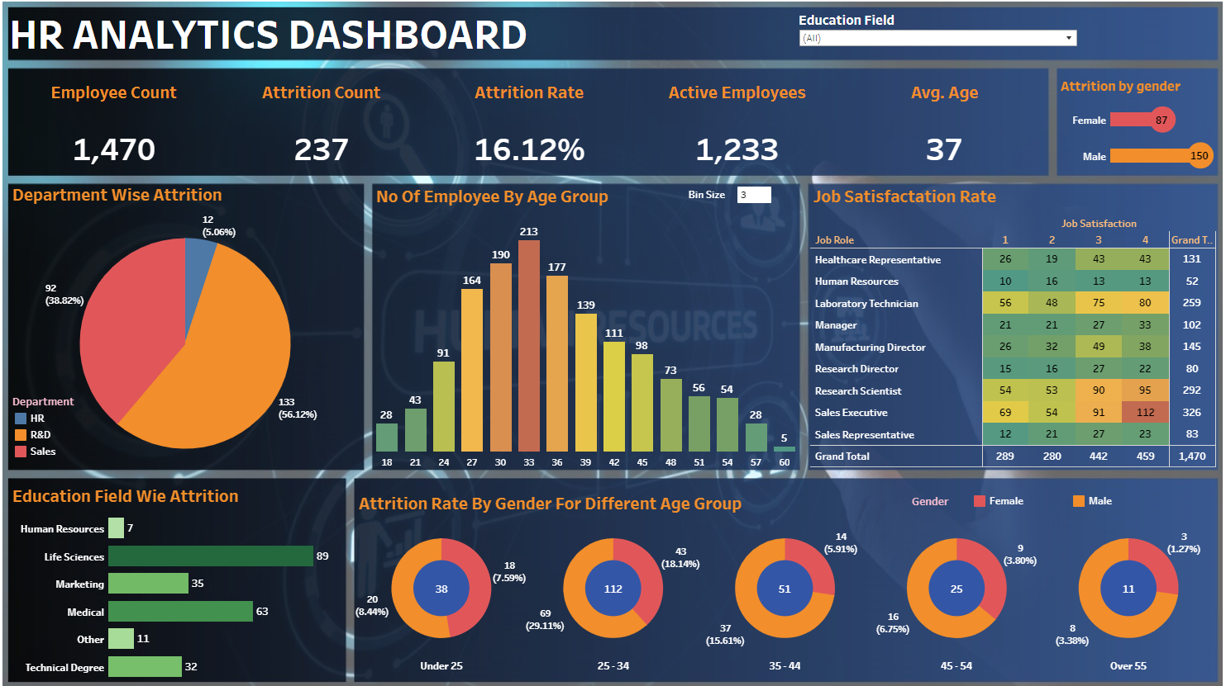
1) Considering all departments
Department wise attrition R&D > Sales >HR.
Education wise, Life Science is the biggest chunk.
Major attrition are in age group 25-34.
Major number of employees lie in age group 27 – 44.
Attrition of male > Attrition of female
Out 1470 employees 569(~39%) employees are not satisfied by there job which is worrisome (taking job satisfaction 1 and 2 into consideration).

Slide 6
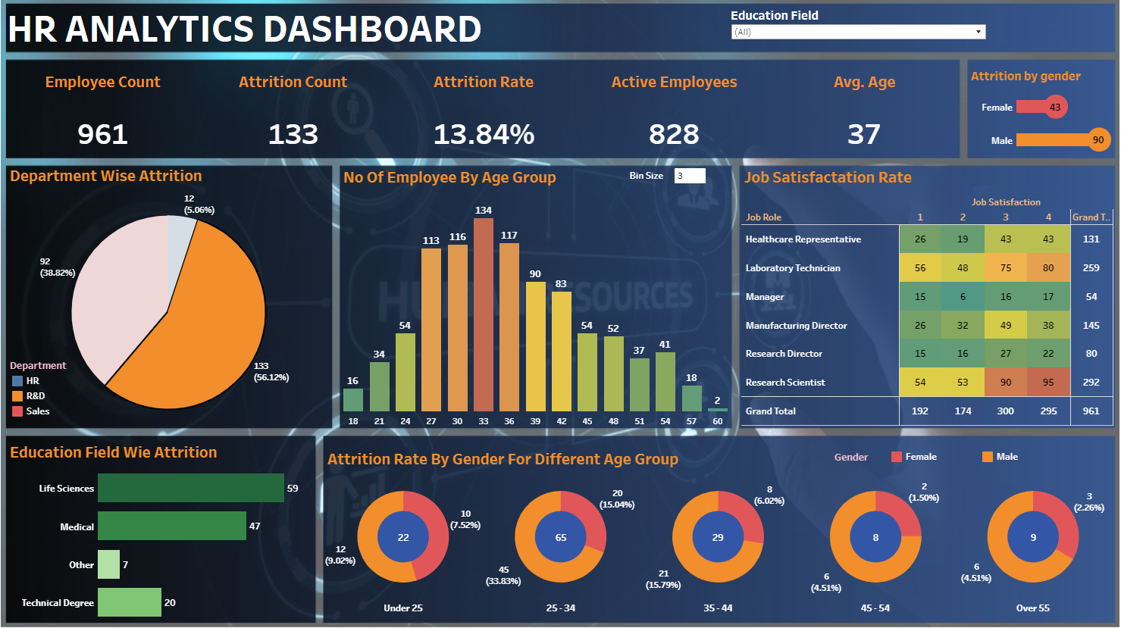
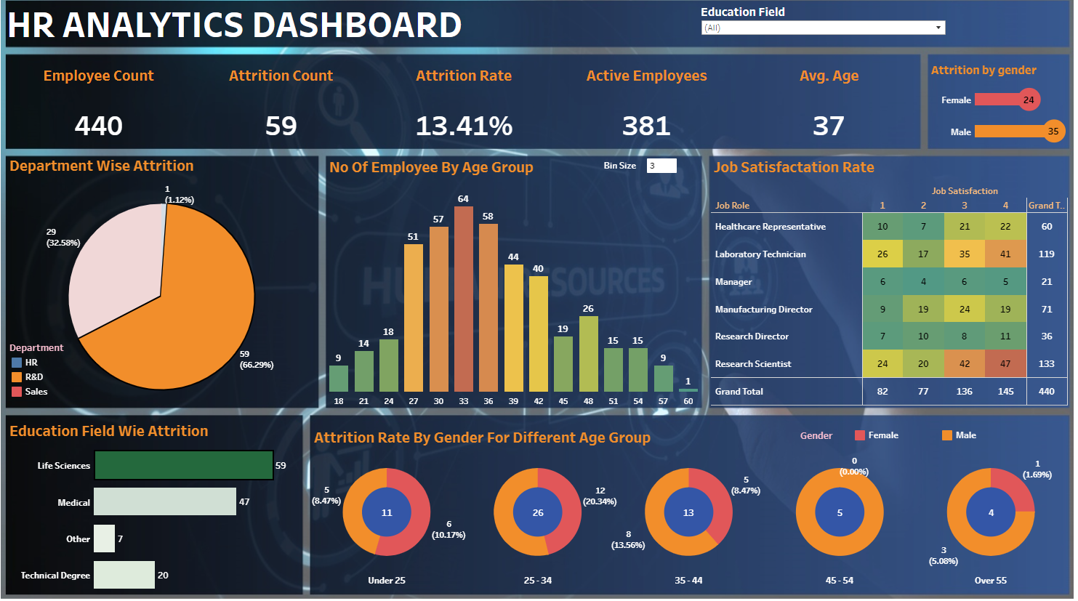
2) Taking R&D into consideration
In R&D department, Life Science is the biggest chunk of that.
Major portion are of the employee in age group between 25-34 (majority are male employees).
The reason for this as seen around 159 (~36%) of employees are not satisfied with their job (taking job satisfaction 1 and 2 into consideration).
If we take gender into consideration than there are nearly equal proportion of male and female are there who are not satisfies by their jobs.
Also if we consider in all age group then the number of male attrition(35) are more than female attrition(24).

Slide 7
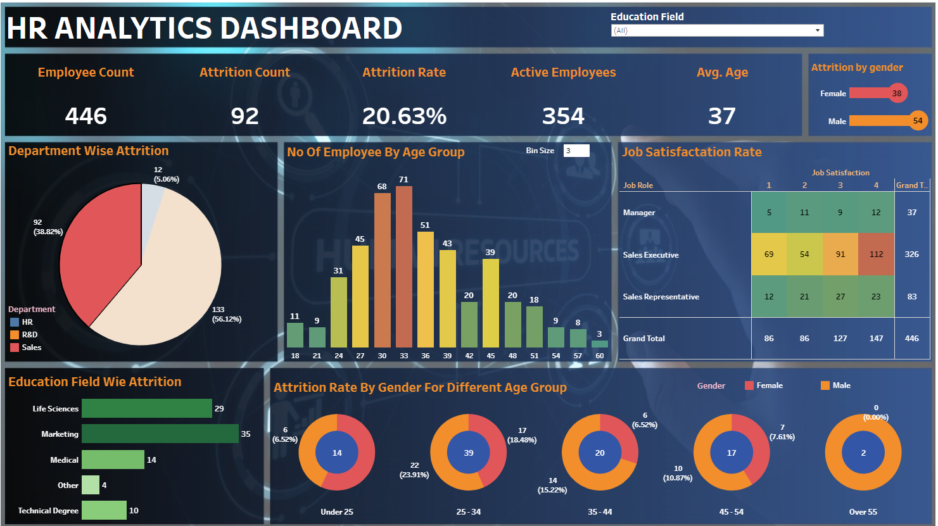
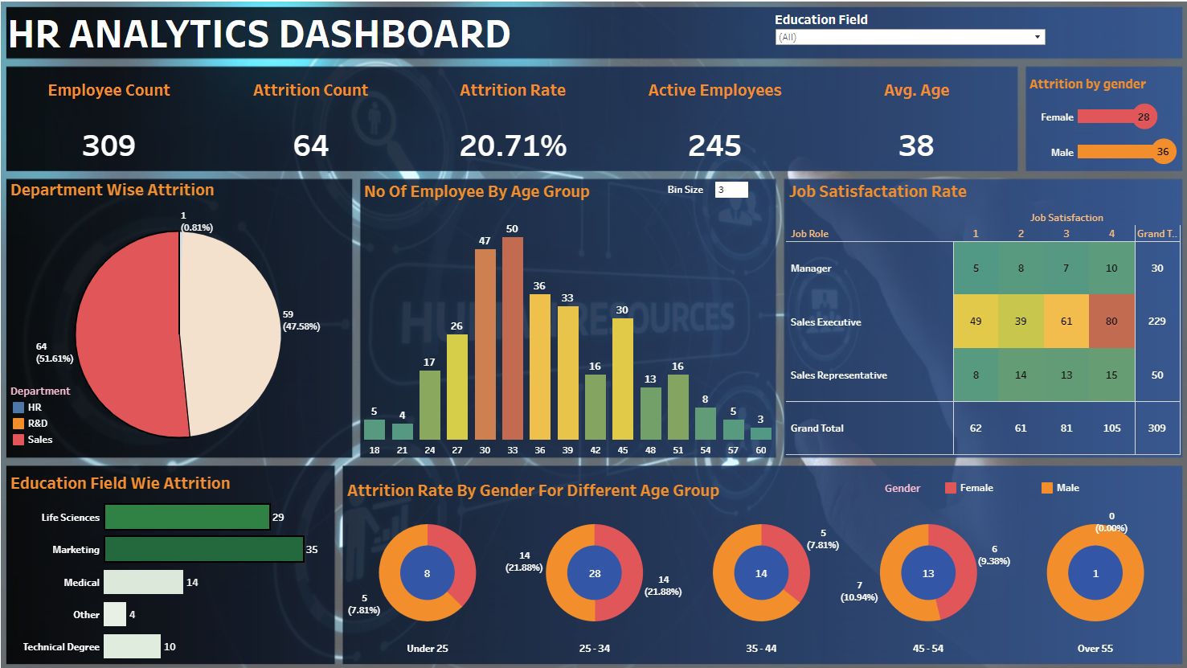
3) Taking Sales into consideration
In Sales department, Marketing and Life Science are the biggest chunk of that.
Major portion are of the employee in age group between 25-34.
The reason for this as seen around 123(~40%) of employees are not satisfied with their job (taking job satisfaction 1 and 2 into consideration).
If we take gender into consideration than there are equal proportion of male and female are there who are not satisfies by their jobs.
Also if we consider in all age group then the number of male attrition(36) are more than female attrition(28).

Slide 8
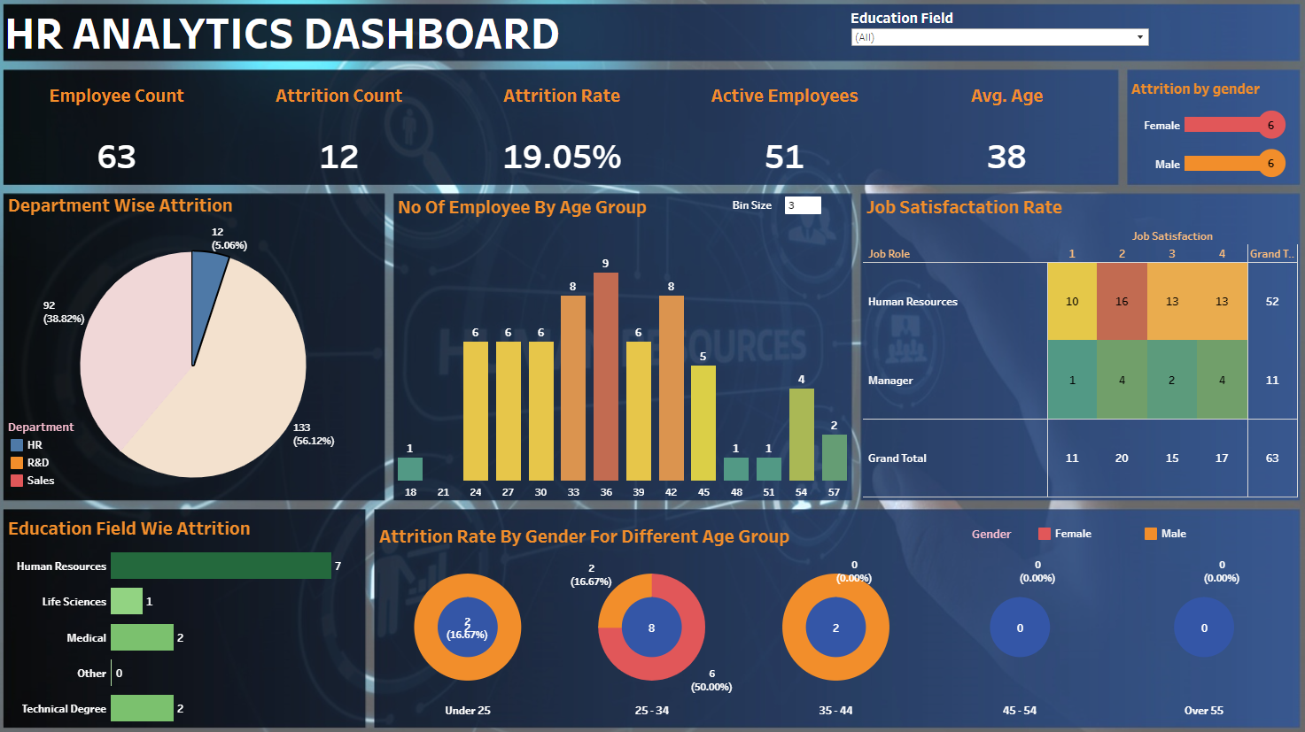
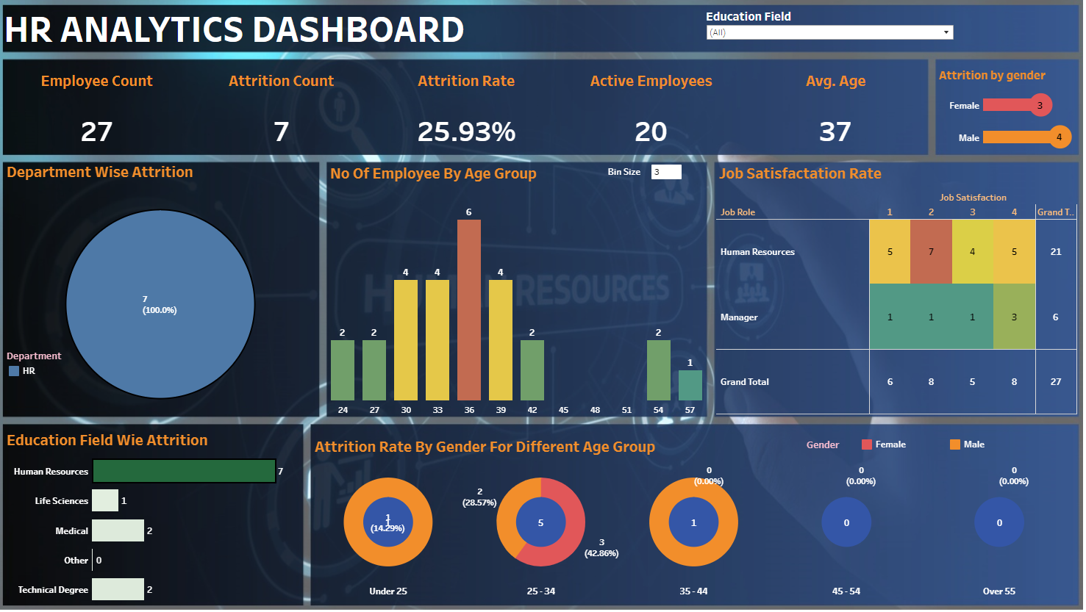
4) Taking HR into consideration
In HR department, Human resources is the biggest chunk of that.
Major portion are of the employee in age group between 25-34.
The reason for this as seen around 14(~52%) of employees are not satisfied with their job (taking job satisfaction 1 and 2 into consideration).
If we take gender into consideration than there are equal proportion of male and female are there who are not satisfies by their jobs.
Also if we consider in all age group then the number of male attrition(4) are more than female attrition(3).

Slide 9
2) Conclusion & Suggestions
1) The maximum attrition is taking place among employees in the age group of 25-34 years .
These are the segment of employees who are most likely to switch jobs are those with experience between 2-4 years.
Ways to reduce this attrition:-
Set realistic expectations
Offer support and show appreciation
Compensate fairly and recognize high performers
Allow for a more flexible work schedule.
2) In education field Major attrition are shown in Life sciences , Marketing and Human resource.
Ways to reduce attrition:-
Making sure that the right people are in the right roles at the right team.
3) Attrition among Male are more as compared to Females.
Lack of gender equality in the workplace has become a sore spot for organisation as it can harm the company by increasing employee attrition.
Ways to reduce attrition:-
Bridging the gender pay gap.
Increase child care and paid time off.
Offer bias training for hiring management.

Slide 10
Thank You

